Slide 1
Data Structure -Arrays
Prepared By Mr . Venkatesh H

Slide 2
Linear Arrays
A linear array is a list of a finite number of n homogeneous data elements ( that is data elements of the same type) such that
The elements are of the arrays are referenced respectively by an index set consisting of n consecutive numbers
The elements of the arrays are stored respectively in successive memory locations

Slide 3
The number n of elements is called the length or size of the array.
The index set consists of the integer 1, 2, … n
Length or the number of data elements of the array can be obtained from the index set by
Length = UB – LB + 1 where UB is the largest index called the upper bound and LB is the smallest index called the lower bound of the arrays

Slide 4
Element of an array A may be denoted by
Subscript notation A₁, A₂, , …. , A_{n}
Parenthesis notation A(1), A(2), …. , A(n)
Bracket notation A[1], A[2], ….. , A[n]
The number K in A[K] is called subscript or an index and A[K] is called a subscripted variable

Slide 5
Representation of Linear Array in Memory
1000
1001
1002
1003
1004
1005
:
Computer Memory

Slide 6
Let LA be a linear array in the memory of the computer
LOC(LA[K]) = address of the element LA[K] of the array LA
The element of LA are stored in the successive memory cells
Computer does not need to keep track of the address of every element of LA, but need to track only the address of the first element of the array denoted by Base(LA) called the base address of LA

Slide 7
LOC(LA[K]) = Base(LA) + w(K – lower bound) where w is the number of words per memory cell of the array LA [w is aka size of the data type]

Slide 8
Example 1
200
201
202
203
204
205
206
207
LA[1]
LA[2]
Find the address for LA[6]
Each element of the array occupy 1 byte
LA[3]
LA[4]
LA[5]
LA[6]
LA[7]
LA[8]
LOC(LA[K]) = Base(LA) + w(K – lower bound)
:
LOC(LA[6]) = 200 + 1(6 – 1) = 205

Slide 9
Example 2
200
201
202
203
204
205
206
207
Find the address for LA[16]
Each element of the array occupy 2 byte
LA[1]
LA[2]
LA[3]
LA[4]
:
LOC(LA[K]) = Base(LA) + w(K – lower bound)
LOC(LA[16]) = 200 + 2(16 – 1) = 230
9

Slide 10
Representation of Linear Array in Memory
Given any value of K, time to calculate LOC(LA[K]) is same
Given any subscript K one can access and locate the content of LA[K] without scanning any other element of LA
A collection A of data element is said to be index if any element of A called A_{k} can be located and processed in time that is independent of K

Slide 11
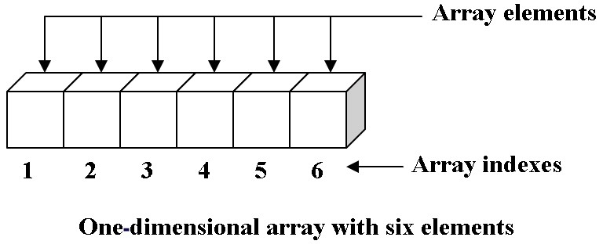
Array as Abstract Data Type
The array is an abstract data type (ADT) that holds a collection of elements accessible by an index.
The elements stored in an array can be anything from primitives types such as integers to more complex types like instances of classes.
An element is stored in a given index and they can be retrieved at a later time by specifying the same index.
The Array (ADT) have one property, they store and retrieve elements using an index. The array (ADT) is usually implemented by an Array (Data Structure).

Slide 12
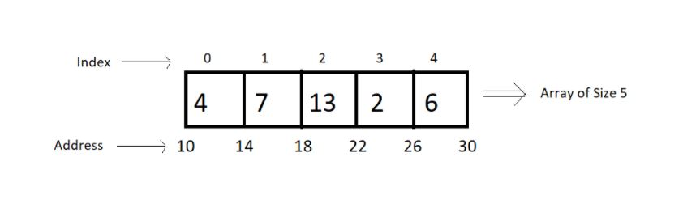
Memory Representations of Array:
Elements in an array are stored in contiguous memory locations.
Elements in an array can be accessed using the base address in constant time → O (1).
Although changing the size of an array is not possible, one can always reallocate it to some bigger memory location. Therefore resizing in an array is a costly operation.

Slide 13
Continue…
Advantages
Fast, random access of items or elements.
Very memory efficient, very little memory is needed other than that needed to store the contents.
Disadvantages
Slow insertion and deletion of elements
Array size must be known when the array is created and is fixed (static).

Slide 14
Operations on linear arrays
We can perform various operations on a linear array:
Traversing- processing each element of the array list.
Inserting- adding new elements in the array list.
Deleting- removing an element from the array list.
Sorting- arranging the elements of the list in some sorting order.
Merging- combining the elements of two array lists in a single array list.

Slide 15
Traversing Linear Arrays
Traversing is accessing and processing (aka visiting ) each element of the data structure exactly one
Linear Array
•••

Slide 16
Traversing Linear Arrays
Traversing is accessing and processing (aka visiting ) each element of the data structure exactly one
Linear Array
•••

Slide 17
Traversing Linear Arrays
Traversing is accessing and processing (aka visiting ) each element of the data structure exactly one
Linear Array
•••

Slide 18
Traversing Linear Arrays
Traversing is accessing and processing (aka visiting ) each element of the data structure exactly one
Linear Array
•••

Slide 19
Traversing Linear Arrays
Traversing is accessing and processing (aka visiting ) each element of the data structure exactly one
Linear Array
•••

Slide 20
Traversing Linear Arrays
Traversing is accessing and processing (aka visiting ) each element of the data structure exactly one
Linear Array
•••
Repeat for K = LB to UB
Apply PROCESS to LA[K]
[End of Loop]
2. Exit

Slide 21
Inserting and Deleting
Insertion: Adding an element
Beginning
Middle
End
Deletion: Removing an element
Beginning
Middle
End

Slide 22
Insertion
1 | Brown
2 | Davis
3 | Johnson
4 | Smith
5 | Wagner
6
7
8
1 | Brown
2 | Davis
3 | Johnson
4 | Smith
5 | Wagner
6 | Ford
7
8
Insert Ford at the End of Array

Slide 23
Insertion
1 | Brown
2 | Davis
3 | Johnson
4 | Smith
5 | Wagner
6
7
8
1 | Brown
2 | Davis
3 | Johnson
4 | Smith
5
6 | Wagner
7
8
1 | Brown
2 | Davis
3 | Johnson
4
5 | Smith
6 | Wagner
7
8
1 | Brown
2 | Davis
3
4 | Johnson
5 | Smith
6 | Wagner
7
8
Ford
Insert Ford as the 3rd Element of Array
Insertion is not Possible without loss of data if the array is FULL

Slide 24
Deletion
1 | Brown
2 | Davis
3 | Ford
4 | Johnson
5 | Smith
6 | Taylor
7 | Wagner
8
1 | Brown
2 | Davis
3 | Ford
4 | Johnson
5 | Smith
6 | Taylor
7
8
Deletion of Wagner at the End of Array

Slide 25
Deletion
1 | Brown
2 | Davis
3 | Ford
4 | Johnson
5 | Smith
6 | Taylor
7 | Wagner
8
1 | Brown
2
3 | Ford
4 | Johnson
5 | Smith
6 | Taylor
7 | Wagner
8
1 | Brown
2 | Ford
3
4 | Johnson
5 | Smith
6 | Taylor
7 | Wagner
8
1 | Brown
2 | Ford
3 | Johnson
4
5 | Smith
6 | Taylor
7 | Wagner
8
Deletion of Davis from the Array

Slide 26
Deletion
1 | Brown
2 | Ford
3 | Johnson
4 | Smith
5 | Taylor
6 | Wagner
7
8
No data item can be deleted from an empty array

Slide 27
Insertion Algorithm
INSERT (LA, N , K , ITEM) [LA is a linear array with N elements and K is a positive integers such that K ≤ N. This algorithm insert an element ITEM into the K^{th} position in LA ]
1. [Initialize Counter] Set J := N
2. Repeat Steps 3 and 4 while J ≥ K
3. [Move the J^{th} element downward ] Set LA[J + 1] := LA[J]
4. [Decrease Counter] Set J := J -1
5 [Insert Element] Set LA[K] := ITEM
6. [Reset N] Set N := N +1;
7. Exit

Slide 28
Deletion Algorithm
DELETE (LA, N , K , ITEM) [LA is a linear array with N elements and K is a positive integers such that K ≤ N. This algorithm deletes K^{th} element from LA ]
1. Set ITEM := LA[K]
2. Repeat for J = K to N -1:
3. Repeat 5 and 6th step while j<=n-1
4. [Move the J + 1st element upward] Set LA[J] := LA[J + 1]
5. j=j+1
6. [Reset the number N of elements] Set N := N - 1;
7. Exit

Slide 29
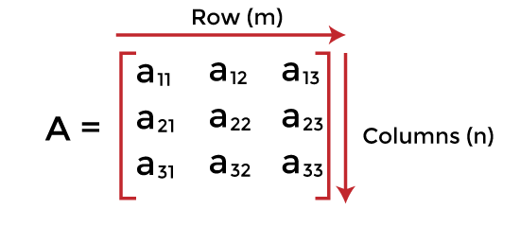
Matrices and Sparse matrices
What is a matrix?
A matrix can be defined as a two-dimensional array having 'm' rows and 'n' columns. A matrix with m rows and n columns is called m × n matrix. It is a set of numbers that are arranged in the horizontal or vertical lines of entries.

Slide 30
What is a sparse matrix?
Sparse matrices are those matrices that have the majority of their elements equal to zero. In other words, the sparse matrix can be defined as the matrix that has a greater number of zero elements than the non-zero elements.
Now, the question arises: we can also use the simple matrix to store the elements, then why is the sparse matrix required?

Slide 31
Why is a sparse matrix required if we can use the simple matrix to store elements?
There are the following benefits of using the sparse matrix -
Storage - We know that a sparse matrix contains lesser non-zero elements than zero, so less memory can be used to store elements. It evaluates only the non-zero elements.
Computing time: In the case of searching in sparse matrix, we need to traverse only the non-zero elements rather than traversing all the sparse matrix elements. It saves computing time by logically designing a data structure traversing non-zero elements.

Slide 32
Representation of sparse matrix
Now, let's see the representation of the sparse matrix. The non-zero elements in the sparse matrix can be stored using triplets that are rows, columns, and values.
There are two ways to represent the sparse matrix that are listed as follows -
Array representation
Linked list representation

Slide 33
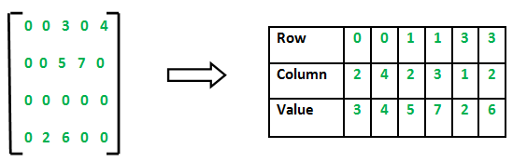
Array representation of the sparse matrix
2D array is used to represent a sparse matrix in which there are three rows named as
Row: Index of row, where non-zero element is located
Column: Index of column, where non-zero element is located
Value: Value of the non zero element located at index – (row,column)

Slide 34
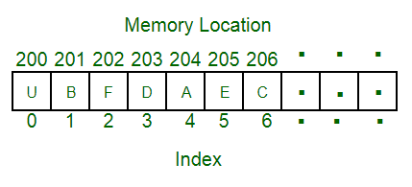
Application of arrays
Arrays are the simplest data structures that stores items of the same data type. A basic application of Arrays can be storing data in tabular format. For example, if we wish to store the contacts on our phone, then the software will simply place all our contacts in an array.
Some other applications of the arrays are:
Arrangement of leader-board of a game can be done simply through arrays to store the score and arrange them in descending order to clearly make out the rank of each player in the game.
A simple question Paper is an array of numbered questions with each of them assigned to some marks.
2D arrays, commonly known as, matrix, are used in image processing.
It is also used in speech processing, in which each speech signal is an array.

Slide 35
Applications of Arrays
Array stores data elements of the same data type.
Maintains multiple variable names using a single name. Arrays help to maintain large data under a single variable name. This avoid the confusion of using multiple variables.

Slide 36
Preliminaries: Mathematical notations and functions
Mathematical notations and functions
1. Floor Functions
2. Ceiling Functions
3. Remainder Functions
4. Exponential Functions
5. Logarithmic Functions

Slide 37
Preliminaries: Mathematical notations and functions
1. Floor Functions: The floor function for any real number x is defined as f (x) is the greatest integer 1 less than or equal to x. It is denoted by [x].
Example: Determine the value of
(i)[3. 5] (ii)[-2.4] (iii)[3. 143].
Solution:
(i)[3 . 5] = 3 (ii) [-2 .4] = -3 (iii) [3. 143] = 3

Slide 38
Continue…
2. Ceiling Functions: The ceiling function for any real number x is defined as h (x) is the smallest integer greater than or equal to x. It is denoted by [x].
Example: Determine the value of
(i)[3. 5] (ii) [-2.4] (iii) [3. 143].
Solution:
(i)[3. 5] = 4
(ii) [-2 .4] = -2
(iii) [3. 143] = 4.

Slide 39
Continue…
3. Remainder Functions: The integer remainder is obtained when some a is divided by m. It is denoted by a (MOD m). We can also define it as, a (MOD m) is the unique integer t such that a = Mq + t. Here q is quotient 0 ≤ r < M.
Example: Determine the value of the following:
35 (MOD 7) (ii) 20 (MOD 3) (iii) 4 (MOD 9)
Solution:
(i) 35 (MOD 7) = 0 (ii) 20 (MOD 3) = 2 (iii) 4 (MOD 9) = 4

Slide 40
Continue...
4. Exponential Functions: Consider two sets A and B. Let A = B = I+ and also let f: A → B be defined by f (n) = kn. Here n is a +ve integer. The function f is called the base k exponential function.
Example: Determine the value of the following:
(i) 10³ (ii) 5^{1/2}
Solution:
10³= 10. 10. 10 = 1000
5^{1/2}=2.23607

Slide 41
Continue…
5. Logarithmic Functions: Consider two sets A and B. Let A = B = R (the set of real numbers and also let f_n:A→B be defined for each positive integer n > 1 as fn (x)=logn(x) the base n of x.
Example: Determine the value of the following:
(i) log₂?16 (ii) log₂ 100
Solution:
(i)log₂16 = 4 as 2⁴=16.
(ii)log₂ 100 = 6 as 2⁶= 64 but 2⁷=128 which is greater

Slide 42
Algorithmic analysis
Asymptotic analysis of an algorithm refers to defining the mathematical boundation/framing of its run-time performance. Using asymptotic analysis, we can very well conclude the best case, average case, and worst case scenario of an algorithm.
Usually, the time required by an algorithm falls under three types −
Best Case − Minimum time required for program execution.
Average Case − Average time required for program execution.
Worst Case − Maximum time required for program execution.

Slide 43
Asymptotic Notations
Asymptotic Notations
Asymptotic Notations are used to describe the execution time of an algorithm.
The notations show the order of growth of functions.
Here the time taken by an algorithm is mapped regarding mathematical functions.
There are many asymptotic notations like 0, θ, Ω,w each having its importance.
Following are the commonly used asymptotic notations to calculate the running time complexity of an algorithm.
Ο Notation
Ω Notation
θ Notation

Slide 44
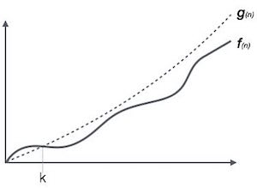
Big Oh Notation, Ο
The notation Ο(n) is the formal way to express the upper bound of an algorithm's running time. It measures the worst case time complexity or the longest amount of time an algorithm can possibly take to complete.
For example, for a function f(n)
Ο(f(n)) = { g(n) : there exists c > 0 and n₀ such that f(n) ≤ c.g(n) for all n > n₀. }

Slide 45
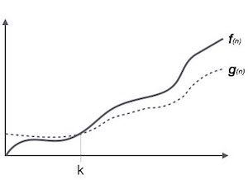
Omega Notation, Ω
The notation Ω(n) is the formal way to express the lower bound of an algorithm's running time. It measures the best case time complexity or the best amount of time an algorithm can possibly take to complete.
For example, for a function f(n)
Ω(f(n)) ≥ { g(n) : there exists c > 0 and n₀ such that g(n) ≤ c.f(n) for all n > n₀. }

Slide 46
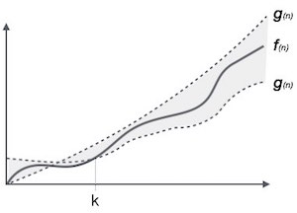
Theta Notation, θ
The notation θ(n) is the formal way to express both the lower bound and the upper bound of an algorithm's running time. It is represented as follows −
θ(f(n)) = { g(n) if and only if g(n) = Ο(f(n)) and g(n) = Ω(f(n)) for all n > n₀. }

Slide 47
Control Structures
Control Structures are just a way to specify flow of control in programs.
Any algorithm or program can be more clear and understood if they use self-contained modules called as logic or control structures. It basically analyses and chooses in which direction a program flows based on certain parameters or conditions. There are three basic types of logic, or flow of control, known as:
Sequence logic, or sequential flow
Selection logic, or conditional flow
Iteration logic, or repetitive flow

Slide 48
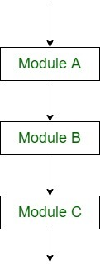
Sequential Logic (Sequential Flow)
Sequential Logic (Sequential Flow)
Sequential logic as the name suggests follows a serial or sequential flow in which the flow depends on the series of instructions given to the computer. Unless new instructions are given, the modules are executed in the obvious sequence. The sequences may be given, by means of numbered steps explicitly. Also, implicitly follows the order in which modules are written. Most of the processing, even some complex problems, will generally follow this elementary flow pattern.
Sequential Control flow

Slide 49
Selection Logic (Conditional Flow)
Selection Logic (Conditional Flow)Selection Logic simply involves a number of conditions or parameters which decides one out of several written modules. The structures which use these type of logic are known as Conditional Structures.
These structures can be of three types:
Single Alternative
Double Alternative
Multiple Alternatives

Slide 50
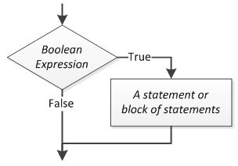
Continue…
Single Alternative This structure has the form:
If (condition) then:
[Module A]
[End of If structure]

Slide 51
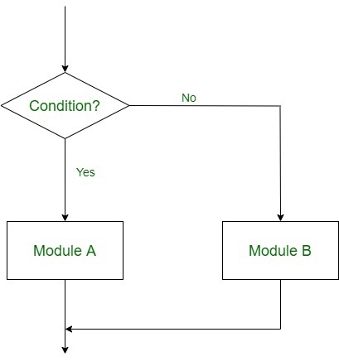
Continue…
Double Alternative This structure has the form:
If (Condition), then:
[Module A]
Else:
[Module B]
[End if structure]
Double Alternative Control Flow

Slide 52
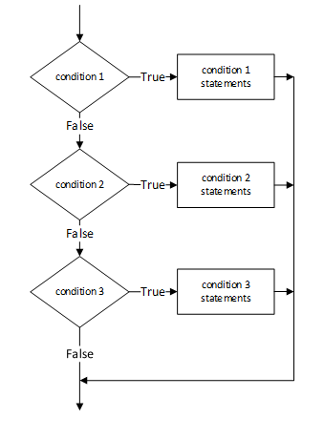
Continue…
Multiple Alternatives This structure has the form:
If (condition A), then:
[Module A]
Else if (condition B), then:
[Module B]
..
..
Else if (condition N), then:
[Module N]
[End If structure]

Slide 53
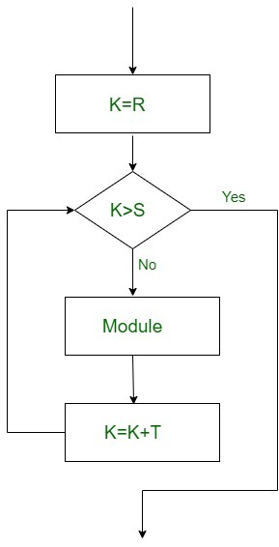
Iteration Logic (Repetitive Flow)
Iteration Logic (Repetitive Flow)
The Iteration logic employs a loop which involves a repeat statement followed by a module known as the body of a loop.
The two types of these structures are:
Repeat-For Structure
This structure has the form:
Repeat for i = A to N by I:
[Module]
[End of loop]
Here, A is the initial value, N is the end value and I is the increment. The loop ends when A>B. K increases or decreases according to the positive and negative value of I respectively.

Slide 54
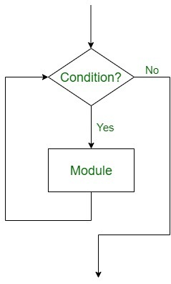
Continue…
Repeat-While Structure
It also uses a condition to control the loop.
This structure has the form:
Repeat while condition:
[Module]
[End of Loop]

Slide 55
Complexity of algorithms
What Is Time Complexity?
Time complexity is a type of computational complexity that describes the time required to execute an algorithm. The time complexity of an algorithm is the amount of time it takes for each statement to complete. As a result, it is highly dependent on the size of the processed data. It also aids in defining an algorithm's effectiveness and evaluating its performance.
What Is Space Complexity?
When an algorithm is run on a computer, it necessitates a certain amount of memory space. The amount of memory used by a program to execute it is represented by its space complexity. Because a program requires memory to store input data and temporal values while running, the space complexity is auxiliary and input space.

Slide 56
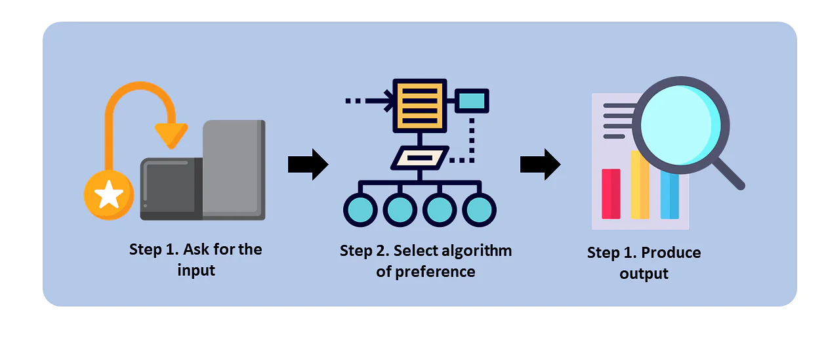
What Does It Take To Develop a Good Algorithm?
A good algorithm executes quickly and saves space in the process. You should find a happy medium of space and time (space and time complexity), but you can do with the average.

